Slide 1
Chapter 2
Computer System Architectures
Based on
Digital Design and Computer Architecture, 2nd Edition
David Money Harris and Sarah L. Harris

Slide 2
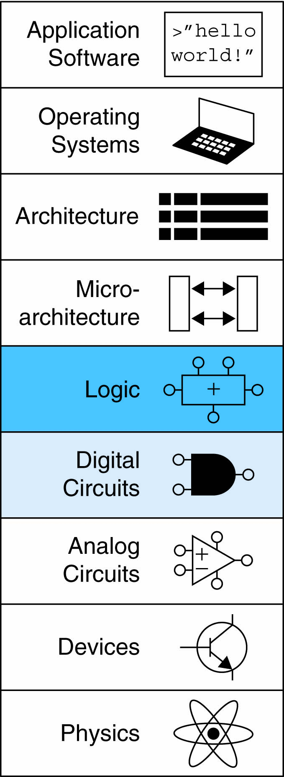
Chapter 2 :: Topics
Introduction
Boolean Equations
Boolean Algebra
From Logic to Gates
Multilevel Combinational Logic
X’s and Z’s, Oh My
Karnaugh Maps
Combinational Building Blocks
Timing

Slide 3
Introduction
A logic circuit is composed of:
Inputs
Outputs
Functional specification
Timing specification
Notes:
In digital electronics, a circuit is a network that processes discrete-valued variables.
A circuit can be viewed as a black box, shown in Figure with
▶ one or more discrete-valued input terminals
▶ one or more discrete-valued output terminals
▶ a functional specification describing the relationship between inputs and outputs
▶ a timing specification describing the delay between inputs changing and outputs responding.

Slide 4
Circuits
Nodes
  Inputs: A, B, C
  Outputs: Y, Z
  Internal: n1
Circuit elements
  E1, E2, E3
  Each a circuit
Notes:
Peering inside the black box, circuits are composed of nodes and elements.
An element is itself a circuit with inputs, outputs, and a specification.
A node is a wire, whose voltage conveys a discrete-valued variable.
Nodes are classified as input, output, or internal.
Inputs receive values from the external world.
Outputs deliver values to the external world.
Wires that are not inputs or outputs are called internal nodes.

Slide 5
Types of Logic Circuits
Combinational Logic
  Memoryless
  Outputs determined by current values of inputs
Sequential Logic
  Has memory
  Outputs determined by previous and current values of inputs
Notes:
Digital circuits are classified as combinational or sequential.
A combinational circuit’s outputs depend only on the current values of the inputs; for example, a logic gate is a combinational circuit.
A sequential circuit’s outputs depend on both current and previous values of the inputs; in other words, it depends on the input sequence.
The functional specification of a combinational circuit expresses the output values in terms of the current input values.
The timing specification of a combinational circuit consists of lower and upper bounds on the delay from input to output.

Slide 6
Rules of Combinational Composition
Every element is combinational
Every node is either an input or connects to exactly one output
The circuit contains no cyclic paths
Example:
Notes:
The rules of combinational composition tell us how we can build a large combinational circuit from smaller combinational circuit elements.
A circuit is combinational if it consists of interconnected circuit elements such that
▶ Every circuit element is itself combinational.
▶ Every node of the circuit is either designated as an input to the circuit or connects to exactly one output terminal of a circuit element.
▶ The circuit contains no cyclic paths: every path through the circuit visits each circuit node at most once.

Slide 7
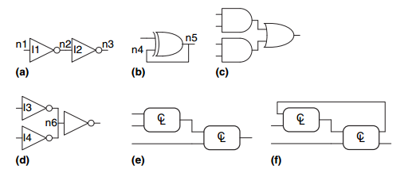
Rules of Combinational Composition
a) is combinational
b) is not combinational
c) is combinational
d) is not combinational
e) is combinational
f) is not combinational
Notes:
The rules of combinational composition tell us how we can build a large combinational circuit from smaller combinational circuit elements.
A circuit is combinational if it consists of interconnected circuit elements such that
▶ Every circuit element is itself combinational.
▶ Every node of the circuit is either designated as an input to the circuit or connects to exactly one output terminal of a circuit element.
▶ The circuit contains no cyclic paths: every path through the circuit visits each circuit node at most once.

Slide 8
Boolean Equations
Functional specification of outputs in terms of inputs
Example: S = F(A, B, C_{in})
C_{out} = F(A, B, C_{in})
Notes:
Viewing a circuit as a black box with a well-defined interface and function is an application of abstraction and modularity.
Building the circuit out of smaller circuit elements is an application of hierarchy.
The rules of combinational composition are an application of discipline.
The functional specification of a combinational circuit is usually expressed as a truth table or a Boolean equation.

Slide 9
Some Definitions
Complement: variable with a bar over it
A, B, C
Literal: variable or its complement
A, A, B, B, C, C
Implicant: product of literals
ABC, AC, BC
Minterm: product that includes all input variables
ABC, ABC, ABC
Maxterm: sum that includes all input variables
(A+B+C), (A+B+C), (A+B+C)
Notes:
The complement of a variable A is its inverse !A.
The variable or its complement is called a literal.
We call A the true form of the variable and !A the complementary form; “true form” does not mean that A is TRUE, but merely that A does not have a line over it.
The AND of one or more literals is called a product or an implicant.
A minterm is a product involving all of the inputs to the function.
A maxterm is a sum involving all of the inputs to the function.

Slide 10
Sum-of-Products (SOP) Form
All equations can be written in SOP form
Each row has a minterm
A minterm is a product (AND) of literals
Each minterm is TRUE for that row (and only that row)
Form function by ORing minterms where the output is TRUE
Thus, a sum (OR) of products (AND terms)
Y = F(A, B) =
Notes:
A truth table of N inputs contains 2^N rows, one for each possible value of the inputs.
Each row in a truth table is associated with a minterm that is TRUE for that row.

Slide 11
Sum-of-Products Form
Sum-of-Products (SOP) Form
All equations can be written in SOP form
Each row has a minterm
A minterm is a product (AND) of literals
Each minterm is TRUE for that row (and only that row)
Form function by ORing minterms where the output is TRUE
Thus, a sum (OR) of products (AND terms)
Y = F(A, B) =

Slide 12
Sum-of-Products Form
Sum-of-Products (SOP) Form
All equations can be written in SOP form
Each row has a minterm
A minterm is a product (AND) of literals
Each minterm is TRUE for that row (and only that row)
Form function by ORing minterms where the output is TRUE
Thus, a sum (OR) of products (AND terms)
Y = F(A, B) = AB + AB = Σ(1, 3)
Notes:
Taking the sum of each of the circled minterms gives Y = !AB + AB.
This is called the sum-of-products canonical form of a function because it is the sum (OR) of products (ANDs forming minterms).
The sum-of-products canonical form can also be written in sigma notation using the summation symbol, Σ.
Unfortunately, sum-of-products form does not necessarily generate the simplest equation.
On next slide we show how to write the same function using fewer terms.

Slide 13
Product-of-Sums (POS) Form
All Boolean equations can be written in POS form
Each row has a maxterm
A maxterm is a sum (OR) of literals
Each maxterm is FALSE for that row (and only that row)
Form function by ANDing the maxterms for which the output is FALSE
Thus, a product (AND) of sums (OR terms)
Y = F(A, B) = (A + B)(A + B) = Π(0, 2)
Notes:
Each row of a truth table corresponds to a maxterm that is FALSE for that row.
The product-of-sums canonical form can also be written in pi notation using the product symbol, Π.

Slide 14
Boolean Equations Example
You are going to the cafeteria for lunch
  You won’t eat lunch (E)
  If it’s not open (O) or
  If they only serve corndogs (C)
Write a truth table for determining if you will eat lunch (E).

Slide 15
Boolean Equations Example
You are going to the cafeteria for lunch
  You won’t eat lunch (E)
  If it’s not open (O) or
  If they only serve corndogs (C)
Write a truth table for determining if you will eat lunch (E).

Slide 16
SOP & POS Form
SOP – sum-of-products
POS – product-of-sums

Slide 17
SOP & POS Form
SOP – sum-of-products
POS – product-of-sums
Y = OC
= Σ(2)
Y = (O + C)(O + C)(O + C)
= Π(0, 1, 3)

Slide 18
Boolean Algebra
Axioms and theorems to simplify Boolean equations
Like regular algebra, but simpler: variables have only two values (1 or 0)
Duality in axioms and theorems:
  ANDs and ORs, 0’s and 1’s interchanged
Notes:
Boolean algebra is based on a set of axioms that we assume are correct.
Axioms and theorems we use to simplify Boolean equations. Expression built from truth table does not necessarily lead to the simplest set of logic gates.
Axioms and theorems of Boolean algebra obey the principle of duality.

Slide 19
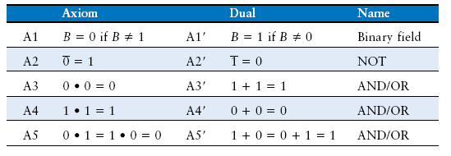
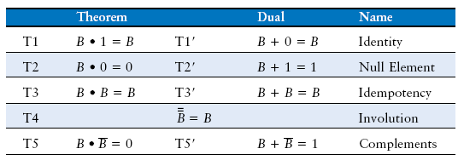
Boolean Axioms
Notes:
The table states the axioms of Boolean algebra.
These five axioms and their duals define Boolean variables and the meanings of NOT, AND, and OR.

Slide 20
T1: Identity Theorem
B 1 = B
B + 0 = B
Notes:
The identity theorem, T1, states that for any Boolean variable B, B AND 1 = B.
Its dual states that B OR 0 = B.

Slide 21
T1: Identity Theorem
B 1 = B
B + 0 = B

Slide 22
T2: Null Element Theorem
B 0 = 0
B + 1 = 1
Notes:
he null element theorem, T2, says that B AND 0 is always equal to 0. Therefore, 0 is called the null element for the AND operation, because it nullifies the effect of any other input.
The dual states that B OR 1 is always equal to 1. Hence, 1 is the null element for the OR operation.

Slide 23
T2: Null Element Theorem
B 0 = 0
B + 1 = 1

Slide 24
T3: Idempotency Theorem
B B = B
B + B = B
Notes:
Idempotency, T3, says that a variable AND itself is equal to just itself.
Likewise, a variable OR itself is equal to itself.

Slide 25
T3: Idempotency Theorem
B B = B
B + B = B

Slide 26
T4: Identity Theorem
B = B
Notes:
Involution, T4, is a fancy way of saying that complementing a variable twice results in the original variable.

Slide 27
T4: Identity Theorem
B = B
Notes:
In digital electronics, two wrongs make a right.

Slide 28
T5: Complement Theorem
B B = 0
B + B = 1
Notes:
The complement theorem states that a variable AND its complement is 0 (because one of them has to be 0).
And by duality, a variable OR its complement is 1 (because one of them has to be 1).

Slide 29
T5: Complement Theorem
B B = 0
B + B = 1

Slide 30
Boolean Theorems Summary

Slide 31
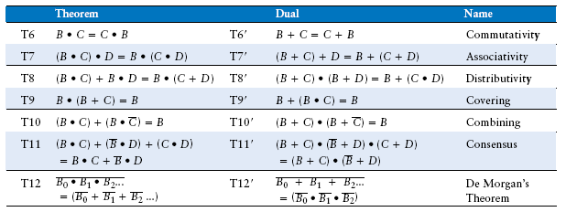
Boolean Theorems of Several Vars

Slide 32
Simplifying Boolean Equations
Example 1:
Y = AB + AB

Slide 33
Simplifying Boolean Equations
Example 1:
Y = AB + AB
= B(A + A) T8
= B(1) T5’
= B T1

Slide 34
Simplifying Boolean Equations
Example 2:
Y = A(AB + ABC)

Slide 35
Simplifying Boolean Equations
Example 2:
Y = A(AB + ABC)
= A(AB(1 + C)) T8
= A(AB(1)) T2’
= A(AB) T1
= (AA)B T7
= AB T3

Slide 36
DeMorgan’s Theorem
Y = AB = A + B
Y = A + B = A B
Notes:
De Morgan’s Theorem, T12, is a particularly powerful tool in digital design.
The theorem explains that the complement of the product of all the terms is equal to the sum of the complement of each term.
Likewise, the complement of the sum of all the terms is equal to the product of the complement of each term.

Slide 37
Bubble Pushing
Backward:
  Body changes
  Adds bubbles to inputs
Forward:
  Body changes
  Adds bubble to output
Notes:
The inversion circle is called a bubble.
The underlying rules for bubble pushing are
▶ Pushing bubbles backward (from the output) or forward (from the inputs) changes the body of the gate from AND to OR or vice versa.
▶ Pushing a bubble from the output back to the inputs puts bubbles on all gate inputs.
▶ Pushing bubbles on all gate inputs forward toward the output puts a bubble on the output.

Slide 38
Bubble Pushing
What is the Boolean expression for this circuit?

Slide 39
Bubble Pushing
What is the Boolean expression for this circuit?
Y = AB + CD

Slide 40
Bubble Pushing Rules
Begin at output, then work toward inputs
Push bubbles on final output back
Draw gates in a form so bubbles cancel

Slide 41
Bubble Pushing Example

Slide 42
Bubble Pushing Example

Slide 43
Bubble Pushing Example

Slide 44
Bubble Pushing Example

Slide 45
From Logic to Gates
Two-level logic: ANDs followed by ORs
Example: Y = ABC + ABC + ABC
Notes:
By drawing schematics in a consistent fashion, we make them easier to read and debug. We will generally obey the following guidelines:
▶ Inputs are on the left (or top) side of a schematic.
▶ Outputs are on the right (or bottom) side of a schematic.
▶ Whenever possible, gates should flow from left to right.
▶ Straight wires are better to use than wires with multiple corners (jagged wires waste mental effort following the wire rather than thinking of what the circuit does).
▶ Wires always connect at a T junction.
▶ A dot where wires cross indicates a connection between the wires.
▶ Wires crossing without a dot make no connection.

Slide 46
Circuit Schematics Rules
Inputs on the left (or top)
Outputs on right (or bottom)
Gates flow from left to right
Straight wires are best

Slide 47
Circuit Schematic Rules (cont.)
Wires always connect at a T junction
A dot where wires cross indicates a connection between the wires
Wires crossing without a dot make no connection

Slide 48
Multiple-Output Circuits
Example: Priority Circuit
Output asserted
corresponding to
most significant
TRUE input

Slide 49
Multiple-Output Circuits
Example: Priority Circuit
Output asserted
corresponding to
most significant
TRUE input

Slide 50
Priority Circuit Hardware

Slide 51
Don’t Cares
Notes:
Notice that if A3 is asserted in the priority circuit, the outputs don’t care what the other inputs are.
We use the symbol X to describe inputs that the output doesn’t care about.

Slide 52
Contention: X
Contention: circuit tries to drive output to 1 and 0
  Actual value somewhere in between
  Could be 0, 1, or in forbidden zone
  Might change with voltage, temperature, time, noise
  Often causes excessive power dissipation
Warnings:
  Contention usually indicates a bug.
  X is used for “don’t care” and contention - look at the context to tell them apart
Notes:
Boolean algebra is limited to 0’s and 1’s.
However, real circuits can also have illegal and floating values, represented symbolically by X and Z.
The symbol X indicates that the circuit node has an unknown or illegal value.
This commonly happens if it is being driven to both 0 and 1 at the same time.
Figure shows a case where node Y is driven both HIGH and LOW.
This situation, called contention.
The actual voltage on a node with contention may be somewhere between 0 and VDD, depending on the relative strengths of the gates driving HIGH and LOW. It is often, but not always, in the forbidden zone.
Contention also can cause large amounts of power to flow between the fighting gates, resulting in the circuit getting hot and possibly damaged.

Slide 53
Floating: Z
Floating, high impedance, open, high Z
Floating output might be 0, 1, or somewhere in between
  A voltmeter won’t indicate whether a node is floating
Tristate Buffer
Notes:
The symbol Z indicates that a node is being driven neither HIGH nor LOW.
The node is said to be floating, high impedance, or high Z.
A floating node does not always mean there is an error in the circuit, so long as some other circuit element does drive the node to a valid logic level when the value of the node is relevant to circuit operation.
The tristate buffer, shown in Figure, has three possible output states: HIGH (1), LOW (0), and floating (Z).
The tristate buffer has an input A, output Y, and enable E.
When the enable is TRUE, the tristate buffer acts as a simple buffer, transferring the input value to the output. When the enable is FALSE, the output is allowed to
float (Z).

Slide 54
Tristate Busses
Floating nodes are used in tristate busses
  Many different drivers
  Exactly one is active at
  once

Slide 55
Karnaugh Maps (K-Maps)
Boolean expressions can be minimized by combining terms
K-maps minimize equations graphically
PA + PA = P
Notes:
Karnaugh maps (K-maps) are a graphical method for simplifying Boolean equations.
K-maps work well for problems with up to four variables.
Each square in the K-map corresponds to a row in the truth table and contains the value of the output Y for that row.

Slide 56
K-Map
Circle 1’s in adjacent squares
In Boolean expression, include only literals whose true and complement form are not in the circle
Y = AB
Notes:
Each square, or minterm, differs from an adjacent square by a change in a single variable.
This means that adjacent squares share all the same literals except one, which appears in true form in one square and in complementary form in the other.
The K-map also “wraps around.”
The squares on the far right are effectively adjacent to the squares on the far left, in that they differ only in one variable, A.

Slide 57
3-Input K-Map

Slide 58
3-Input K-Map
Y = AB + BC

Slide 59
K-Map Definitions
Complement: variable with a bar over it
A, B, C
Literal: variable or its complement
A, A, B, B, C, C
Implicant: product of literals
ABC, AC, BC
Prime implicant: implicant corresponding to the largest circle in a K-map

Slide 60
K-Map Rules
Every 1 must be circled at least once
Each circle must span a power of 2 (i.e. 1, 2, 4) squares in each direction
Each circle must be as large as possible
A circle may wrap around the edges
A “don't care” (X) is circled only if it helps minimize the equation

Slide 61
4-Input K-Map

Slide 62
4-Input K-Map

Slide 63
4-Input K-Map

Slide 64
K-Maps with Don’t Cares

Slide 65
K-Maps with Don’t Cares

Slide 66
K-Maps with Don’t Cares

Slide 67
Combinational Building Blocks
Multiplexers
Decoders
Notes:
Combinational logic is often grouped into larger building blocks to build more complex systems.
This is an application of the principle of abstraction, hiding the unnecessary gate-level details to emphasize the function of the building block.
This lesson introduces two more commonly used building blocks: multiplexers and decoders.

Slide 68
Multiplexer (Mux)
Selects between one of N inputs to connect to output
log₂N-bit select input – control input
Example: 2:1 Mux
Notes:
Multiplexers are among the most commonly used combinational circuits.
They choose an output from among several possible inputs based on the value of a select signal.
A multiplexer is sometimes affectionately called a mux.

Slide 69
Multiplexer Implementations
Logic gates
  Sum-of-products form
Tristates
  For an N-input mux, use N tristates
  Turn on exactly one to select the appropriate input
Notes:
Shorting together the outputs of multiple gates technically violates the rules for combinational circuits.
But because exactly one of the outputs is driven at any time, this exception is allowed.

Slide 70
Logic using Multiplexers
Using the mux as a lookup table
Notes:
Multiplexers can be used as lookup tables to perform logic functions.

Slide 71
Logic using Multiplexers
Reducing the size of the mux
Notes:
With a little cleverness, we can cut the multiplexer size in half, using only a 2^(N–1)-input multiplexer to perform any N-input logic function.
The strategy is to provide one of the literals, as well as 0’s and 1’s, to the multiplexer data inputs.

Slide 72
Decoders
N inputs, 2^{N} outputs
One-hot outputs: only one output HIGH at once
Notes:
A decoder has N inputs and 2^N outputs.
It asserts exactly one of its outputs depending on the input combination.
The outputs are called one-hot, because exactly one is “hot” (HIGH) at a given time.

Slide 73
Decoder Implementation

Slide 74
Logic Using Decoders
OR minterms
Notes:
Decoders can be combined with OR gates to build logic functions.
Because each output of a decoder represents a single minterm, the function is built as the OR of all the minterms in the function.
This concept will be applied to the building of Read Only Memories (ROMs).

Slide 75
Timing
Delay between input change and output changing
How to build fast circuits?
Notes:
An output takes time to change in response to an input change.

Slide 76
Propagation & Contamination Delay
Propagation delay: t_{pd} = max delay from input to output
Contamination delay: t_{cd} = min delay from input to output
Notes:
Combinational logic is characterized by its propagation delay and contamination delay.
The propagation delay tpd is the maximum time from when an input changes until the output or outputs reach their final value.
The contamination delay tcd is the minimum time from when an input changes until any output starts to change its value.

Slide 77
Propagation & Contamination Delay
Delay is caused by
  Capacitance and resistance in a circuit
  Speed of light limitation
Reasons why t_{pd} and t_{cd} may be different:
  Different rising and falling delays
  Multiple inputs and outputs, some of which are faster than others
  Circuits slow down when hot and speed up when cold

Slide 78
Critical (Long) & Short Paths
Critical (Long) Path: t_{pd} = 2t_{pd_AND} + t_{pd_OR}
Short Path: t_{cd} = t_{cd_AND}
Notes:
Along with the factors already listed, propagation and contamination delays are also determined by the path a signal takes from input to output.
The critical path, shown in blue, is the path from input A or B to output Y.
It is the longest, and therefore the slowest, path, because the input travels through three gates to the output.
This path is critical because it limits the speed at which the circuit operates.
The short path through the circuit, shown in gray, is from input D to output Y.
This is the shortest, and therefore the fastest, path through the circuit, because the input travels through only a single gate to the output.
The propagation delay of a combinational circuit is the sum of the propagation delays through each element on the critical path.
The contamination delay is the sum of the contamination delays through each element on the short path.

Slide 79
Glitches
When a single input change causes multiple output changes
Notes:
So far we have discussed the case where a single input transition causes a single output transition.
However, it is possible that a single input transition can cause multiple output transitions.
These are called glitches or hazards.

Slide 80
Glitch Example
What happens when A = 0, C = 1, B falls?

Slide 81
Glitch Example (cont.)

Slide 82
Fixing the Glitch
Notes:
We can eliminate the glitch by adding redundant implicants to the K-map to cover these boundaries.
This of course comes at the cost of extra hardware.

