Slide 1
Chapter 1
Computer System Architectures
Based on
Digital Design and Computer Architecture, 2nd Edition
David Money Harris and Sarah L. Harris

Slide 2
Chapter 1 :: Topics
Background
The Game Plan
The Art of Managing Complexity
The Digital Abstraction
Number Systems
Logic Gates
Logic Levels
CMOS Transistors
Power Consumption

Slide 3
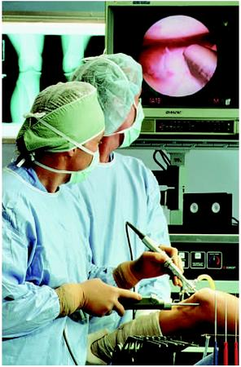
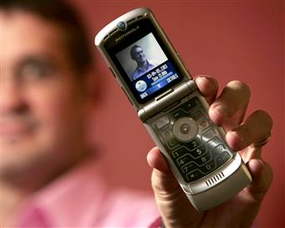

Background
Microprocessors have revolutionized our world
  Cell phones, Internet, rapid advances in medicine, etc.
The semiconductor industry has grown from $21 billion in 1985 to $300 billion in 2011
Notes:
Microprocessors have revolutionized our world during the past three decades.
We are using cell phones, internet, microprocessors influence medicine, etc.
Luxury automobile contains about 50 microprocessors.
Worldwide semiconductor industry sales have grown from US $21 billion in 1985 to $300 billion in 2011, and microprocessors are a major segment of these sales.

Slide 4
The Game Plan
Purpose of course:
  Understand what’s under the hood of a computer
  Learn the principles of digital design
  Learn to systematically debug increasingly complex designs
  Design and build a microprocessor
Notes:
This course focuses on the design of digital systems, which operate on 1’s and 0’s.
We begin with digital logic gates that accept 1’s and 0’s as inputs and produce 1’s and 0’s as outputs.
We then explore how to combine logic gates into more complicated modules such as adders and memories.
Then we make an introduction to programming in assembly language, which is the natural language of the microprocessors.

Slide 5
The Art of Managing Complexity
Abstraction
Discipline
The Three –Y’s
  Hierarchy
  Modularity
  Regularity
Notes:
One of the characteristics that separates an engineer or computer scientist from a layperson is a systematic approach to managing complexity.
Modern digital systems are built from millions or billions of transistors.
No human being could understand these systems by writing equations describing the movement of electrons in each transistor and solving all of the equations simultaneously.

Slide 6
Abstraction
Hiding details when they aren’t important
Notes:
The critical technique for managing complexity is abstraction: hiding details when they are not important.
At the lowest level of abstraction is the physics, the motion of electrons.
Our system is constructed from electronic devices such as transistors, diodes, resistors, capacitors.
These devices can be modeled by the relationship between voltage and current.
By abstracting to this device level, we can ignore the individual electrons.
The next level of abstraction is analog circuits with continuous range of voltages on input and output side of the circuit.
Digital circuits such as logic gates restrict the voltages to discrete ranges, which we will use to indicate 0 and 1.
In logic design, we build more complex structures, such as adders or memories, from digital circuits.
Microarchitecture links the logic and architecture levels of abstraction.
The architecture level of abstraction describes a computer from the programmer’s perspective.
Moving into the software realm, the operating system handles lowlevel details such as accessing a hard drive or managing memory.
Finally, the application software uses these facilities provided by the operating system to solve a problem for the user.

Slide 7
Discipline
Intentionally restrict design choices
Example: Digital discipline
  Discrete voltages instead of continuous
  Simpler to design than analog circuits – can build more sophisticated systems
  Digital systems replacing analog predecessors:
    i.e., digital cameras, digital television, cell phones, CDs
Notes:
Discipline is the act of intentionally restricting your design choices so that you can work more productively at a higher level of abstraction.

Slide 8
The Three -Y’s
Hierarchy
  A system divided into modules and submodules
Modularity
  Having well-defined functions and interfaces
Regularity
  Encouraging uniformity, so modules can be easily reused
Notes:
In addition to abstraction and discipline, designers use the three “-y’s” to manage complexity: hierarchy, modularity, and regularity.
Hierarchy involves dividing a system into modules, then further subdividing each of these modules until the pieces are easy to understand.
Modularity states that the modules have well-defined functions and interfaces, so that they connect together easily without unanticipated side effects.
Regularity seeks uniformity among the modules. Common modules are reused many times, reducing the number of distinct modules that must be designed.

Slide 9
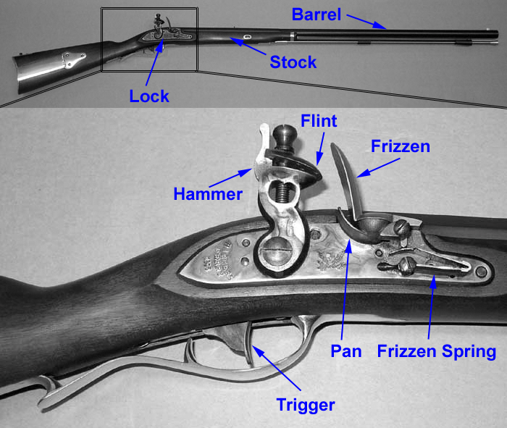
Example: The Flintlock Rifle
Hierarchy
  Three main modules: lock, stock, and barrel
  Submodules of lock: hammer, flint, frizzen, etc.

Slide 10
Example: The Flintlock Rifle
Modularity
  Function of stock: mount barrel and lock
  Interface of stock: length and location of mounting pins
Regularity
  Interchangeable parts

Slide 11
The Digital Abstraction
Most physical variables are continuous
  Voltage on a wire
  Frequency of an oscillation
  Position of a mass
Digital abstraction considers discrete subset of values
Notes:
Most physical variables are continuous.
For example, the voltage on a wire, the frequency of an oscillation, or the position of a mass are all continuous quantities.
Digital systems, on the other hand, represent information with discrete-valued variables—that is, variables with a finite number of distinct values.

Slide 12
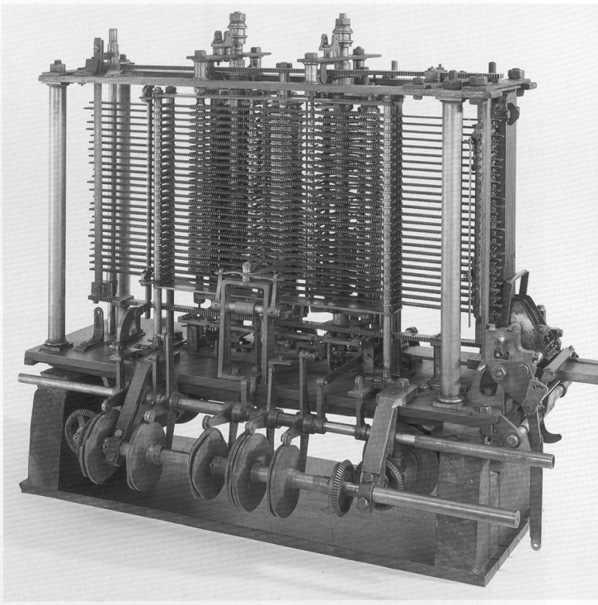
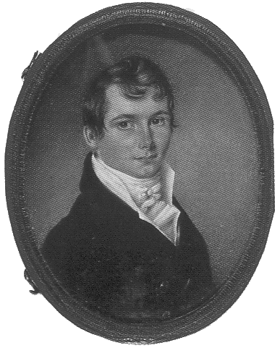
The Analytical Engine
Designed by Charles Babbage from 1834 – 1871
Considered to be the first digital computer
Built from mechanical gears, where each gear represented a discrete value (0-9)
Babbage died before it was finished
Notes:
The Analytical Engine used gears with ten positions labeled 0 through 9.
Babbage chose 25 rows of gears, so the machine has 25-digit precision.

Slide 13
Digital Discipline: Binary Values
Two discrete values:
  1’s and 0’s
  1, TRUE, HIGH
  0, FALSE, LOW
1 and 0: voltage levels, rotating gears, fluid levels, etc.
Digital circuits use voltage levels to represent 1 and 0
Bit: Binary digit
Notes:
The amount of information D in a discrete valued variable with N distinct states is measured in units of bits as D = log(N,2) bits
A binary variable conveys log(2,2) = 1 bit of information. Indeed, the word bit is short for binary digit.
A continuous signal theoretically contains an infinite amount of information because it can take on an infinite number of values.

Slide 14
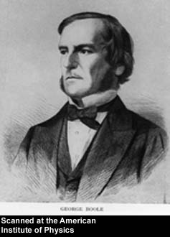
George Boole, 1815-1864
Born to working class parents
Taught himself mathematics and joined the faculty of Queen’s College in Ireland.
Wrote An Investigation of the Laws of Thought (1854)
Introduced binary variables
Introduced the three fundamental logic operations: AND, OR, and NOT.
Notes:
The beauty of the digital abstraction is that digital designers can focus on 1’s and 0’s, ignoring whether the Boolean variables are physically represented with specific voltages.

Slide 15
Number Systems
Decimal numbers
Binary numbers
Notes:
In elementary school, you learned to count and do arithmetic in decimal. Just as you (probably) have ten fingers, there are ten decimal digits: 0, 1, 2, …, 9.
Decimal digits are joined together to form longer decimal numbers. Each column of a decimal number has ten times the weight of the previous column.
From right to left, the column weights are 1, 10, 100, 1000, and so on. Decimal numbers are referred to as base 10.
The base is indicated by a subscript after the number to prevent confusion when working in more than one base.
An N-digit decimal number represents one of 10N possibilities: 0, 1,2, 3, …, 10^N − 1. This is called the range of the number.

Slide 16
Number Systems
Decimal numbers
Binary numbers
Notes:
Bits represent one of two values, 0 or 1, and are joined together to form binary numbers.
Each column of a binary number has twice the weight of the previous column, so binary numbers are base 2.
An N-bit binary number represents one of 2N possibilities: 0, 1, 2, 3, …, 2^N − 1.

Slide 17
Powers of Two
2⁰ =
2¹ =
2² =
2³ =
2⁴ =
2⁵ =
2⁶ =
2⁷ =
2⁸ =
2⁹ =
2¹⁰ =
2¹¹ =
2¹² =
2¹³ =
2¹⁴ =
2¹⁵ =

Slide 18
Powers of Two
2⁰ = 1
2¹ = 2
2² = 4
2³ = 8
2⁴ = 16
2⁵ = 32
2⁶ = 64
2⁷ = 128
Handy to memorize up to 2⁹
2⁸ = 256
2⁹ = 512
2¹⁰ = 1024
2¹¹ = 2048
2¹² = 4096
2¹³ = 8192
2¹⁴ = 16384
2¹⁵ = 32768

Slide 19
Number Conversion
Decimal to binary conversion:
  Convert 10011₂ to decimal
Decimal to binary conversion:
  Convert 47₁₀ to binary

Slide 20
Number Conversion
Decimal to binary conversion:
  Convert 10011₂ to decimal
  16×1 + 8×0 + 4×0 + 2×1 + 1×1 = 19₁₀
Decimal to binary conversion:
  Convert 47₁₀ to binary
  32×1 + 16×0 + 8×1 + 4×1 + 2×1 + 1×1 = 101111₂

Slide 21
Binary Values and Range
N-digit decimal number
  How many values?
  Range?
  Example: 3-digit decimal number:
N-bit binary number
  How many values?
  Range:
  Example: 3-digit binary number:

Slide 22
Binary Values and Range
N-digit decimal number
  How many values? 10^{N}
  Range? [0, 10^{N} - 1]
  Example: 3-digit decimal number:
    10³ = 1000 possible values
    Range: [0, 999]
N-bit binary number
  How many values? 2^{N}
  Range: [0, 2^{N} - 1]
  Example: 3-digit binary number:
    2³ = 8 possible values
    Range: [0, 7] = [000₂ to 111₂]

Slide 23
Hexadecimal Numbers
Hex Digit | Decimal Equivalent | Binary Equivalent
0 | 0
1 | 1
2 | 2
3 | 3
4 | 4
5 | 5
6 | 6
7 | 7
8 | 8
9 | 9
A | 10
B | 11
C | 12
D | 13
E | 14
F | 15
Notes:
Writing long binary numbers becomes tedious and prone to error.
A group of four bits represents one of 24 = 16 possibilities.
Hence, it is sometimes more convenient to work in base 16, called hexadecimal.
Hexadecimal numbers use the digits 0 to 9 along with the letters A to F.

Slide 24
Hexadecimal Numbers
Hex Digit | Decimal Equivalent | Binary Equivalent
0 | 0 | 0000
1 | 1 | 0001
2 | 2 | 0010
3 | 3 | 0011
4 | 4 | 0100
5 | 5 | 0101
6 | 6 | 0110
7 | 7 | 0111
8 | 8 | 1000
9 | 9 | 1001
A | 10 | 1010
B | 11 | 1011
C | 12 | 1100
D | 13 | 1101
E | 14 | 1110
F | 15 | 1111

Slide 25
Hexadecimal Numbers
Base 16
Shorthand for binary

Slide 26
Hexadecimal to Binary Conversion
Hexadecimal to binary conversion:
  Convert 4AF₁₆ (also written 0x4AF) to binary
Hexadecimal to decimal conversion:
  Convert 0x4AF to decimal

Slide 27
Hexadecimal to Binary Conversion
Hexadecimal to binary conversion:
  Convert 4AF₁₆ (also written 0x4AF) to binary
  0100 1010 1111₂
Hexadecimal to decimal conversion:
  Convert 4AF₁₆ to decimal
  16²×4 + 16¹×10 + 16⁰×15 = 1199₁₀

Slide 28
Bits, Bytes, Nibbles…
Bits
Bytes & Nibbles
Bytes
Notes:
A group of eight bits is called a byte.
It represents one of 2^8 = 256 possibilities.
The size of objects stored in computer memories is customarily measured in bytes rather than bits.
Microprocessors handle data in chunks called words. The size of a word depends on the architecture of the microprocessor.
Within a group of bits, the bit in the 1’s column is called the least significant bit (lsb), and the bit at the other end is called the most significant bit (msb).
Similarly, within a word, the bytes are identified as least significant byte (LSB) through most significant byte (MSB).

Slide 29
Large Powers of Two
2¹⁰ = 1 kilo ≈ 1000 (1024)
2²⁰ = 1 mega ≈ 1 million (1,048,576)
2³⁰ = 1 giga ≈ 1 billion (1,073,741,824)

Slide 30
Estimating Powers of Two
What is the value of 2²⁴?
How many values can a 32-bit variable represent?

Slide 31
Estimating Powers of Two
What is the value of 2²⁴?
- 2⁴ × 2²⁰ ≈ 16 million
How many values can a 32-bit variable represent?
-2² × 2³⁰ ≈ 4 billion

Slide 32
Addition
Decimal
Binary
Notes:
Binary addition is much like decimal addition.
As in decimal addition, if the sum of two numbers is greater than what fits in a single digit, we carry a 1 into the next column
the bit that is carried over to the neighboring column is called the carry bit.

Slide 33
Binary Addition Examples
Add the following 4-bit binary numbers
Add the following 4-bit binary numbers

Slide 34
Binary Addition Examples
Add the following 4-bit binary numbers
Add the following 4-bit binary numbers
Overflow!

Slide 35
Overflow
Digital systems operate on a fixed number of bits
Overflow: when result is too big to fit in the available number of bits
See previous example of 11 + 6

Slide 36
Signed Binary Numbers
Sign/Magnitude Numbers
Two’s Complement Numbers
Notes:
So far, we have considered only unsigned binary numbers that represent positive quantities.
We will often want to represent both positive and negative numbers.
Several schemes exist to represent signed binary numbers; the two most widely employed are called sign/magnitude and two’s complement.

Slide 37
Sign/Magnitude Numbers
1 sign bit, N-1 magnitude bits
Sign bit is the most significant (left-most) bit
  Positive number: sign bit = 0
  Negative number: sign bit = 1
Example, 4-bit sign/mag representations of ± 6:
+6 =
- 6 =
Range of an N-bit sign/magnitude number:
Notes:
An N-bit sign/magnitude number uses the most significant bit as the sign and the remaining N−1 bits as the magnitude (absolute value).

Slide 38
Sign/Magnitude Numbers
1 sign bit, N-1 magnitude bits
Sign bit is the most significant (left-most) bit
  Positive number: sign bit = 0
  Negative number: sign bit = 1
Example, 4-bit sign/mag representations of ± 6:
+6 = 0110
- 6 = 1110
Range of an N-bit sign/magnitude number:
[-(2^{N-1}-1), 2^{N-1}-1]

Slide 39
Sign/Magnitude Numbers
Problems:
  Addition doesn’t work, for example -6 + 6:
1110
+ 0110
10100 (wrong!)
  Two representations of 0 (± 0):
1000
0000
Notes:
Unfortunately, ordinary binary addition does not work for sign/ magnitude numbers.

Slide 40
Two’s Complement Numbers
Don’t have same problems as sign/magnitude numbers:
  Addition works
  Single representation for 0
Notes:
Two’s complement numbers are identical to unsigned binary numbers except that the most significant bit position has a weight of −2^(N−1) instead of 2^(N−1).
They overcome the shortcomings of sign/magnitude numbers: zero has a single representation, and ordinary addition works.
In two’s complement representation, zero is written as all zeros.
The most positive number has a 0 in the most significant position and 1’s elsewhere.
The most negative number has a 1 in the most significant position and 0’s elsewhere.

Slide 41
Two’s Complement Numbers
Msb has value of -2^{N-1}
Most positive 4-bit number:
Most negative 4-bit number:
The most significant bit still indicates the sign (1 = negative, 0 = positive)
Range of an N-bit two’s comp number:

Slide 42
Two’s Complement Numbers
Msb has value of -2^{N-1}
Most positive 4-bit number: 0111
Most negative 4-bit number: 1000
The most significant bit still indicates the sign (1 = negative, 0 = positive)
  Range of an N-bit two’s comp number:
  [-(2^{N-1}), 2^{N-1}-1]

Slide 43
“Taking the Two’s Complement”
Flip the sign of a two’s complement number
Method:
    Invert the bits
    Add 1
Example: Flip the sign of 3₁₀ = 0011₂

Slide 44
“Taking the Two’s Complement”
Flip the sign of a two’s complement number
Method:
    Invert the bits
    Add 1
Example: Flip the sign of 3₁₀ = 0011₂
    1100
    + 1
    1101 = -3₁₀

Slide 45
Two’s Complement Examples
Take the two’s complement of 6₁₀ = 0110₂
What is the decimal value of 1001₂?

Slide 46
Two’s Complement Examples
Take the two’s complement of 6₁₀ = 0110₂
    1001
    + 1
    1010₂ = -6₁₀
What is the decimal value of the two’s complement number 1001₂?
    110
    + 1
    111₂ = 7₁₀, so 1001₂ = -7₁₀

Slide 47
Two’s Complement Addition
Add 6 + (-6) using two’s complement numbers
Add -2 + 3 using two’s complement numbers

Slide 48
Two’s Complement Addition
Add 6 + (-6) using two’s complement numbers
Add -2 + 3 using two’s complement numbers
Notes:
Two’s complement numbers have the compelling advantage that addition works properly for both positive and negative numbers.
When adding N-bit numbers, the carry out of the Nth bit (i.e., the N + 1th result bit) is discarded.
Subtraction is performed by taking the two’s complement of the second number, then adding.
Adding two N-bit positive numbers or negative numbers may cause overflow if the result is greater than 2^(N−1) − 1 or less than −2^(N−1).
Adding a positive number to a negative number never causes overflow.
Unlike unsigned numbers, a carry out of the most significant column does not indicate overflow.
Instead, overflow occurs if the two numbers being added have the same sign bit and the result has the opposite sign bit.

Slide 49
Increasing Bit Width
Extend number from N to M bits (M > N) :
  Sign-extension
  Zero-extension

Slide 50
Sign-Extension
Sign bit copied to msb’s
Number value is same
Example 1:
  4-bit representation of 3 = 0011
  8-bit sign-extended value: 00000011
Example 2:
  4-bit representation of -5 = 1011
  8-bit sign-extended value: 11111011

Slide 51
Zero-Extension
Zeros copied to msb’s
Value changes for negative numbers
Example 1:
  4-bit value = 0011₂ = 3₁₀
  8-bit zero-extended value: 00000011 = 3₁₀
Example 2:
  4-bit value = 1011 = -5₁₀
  8-bit zero-extended value: 00001011 = 11₁₀

Slide 52
Number System Comparison
Number System | Range
Unsigned | [0, 2^{N}-1]
Sign/Magnitude | [-(2^{N-1}-1), 2^{N-1}-1]
Two’s Complement | [-2^{N-1}, 2^{N-1}-1]
For example, 4-bit representation:

Slide 53
Logic Gates
Perform logic functions:
  inversion (NOT), AND, OR, NAND, NOR, etc.
Single-input:
  NOT gate, buffer
Two-input:
  AND, OR, XOR, NAND, NOR, XNOR
Multiple-input
Notes:
Now that we know how to use binary variables to represent information, we explore digital systems that perform operations on these binary variables.
Logic gates are simple digital circuits that take one or more binary inputs and produce a binary output.

Slide 54
Single-Input Logic Gates
Notes:
Logic gates are drawn with a symbol showing the input (or inputs) and the output.
Inputs are usually drawn on the left (or top) and outputs on the right (or bottom).
A NOT gate has one input, A, and one output, Y.
The NOT gate’s output is the inverse of its input. The line over A in the Boolean equation is pronounced NOT

Slide 55
Single-Input Logic Gates
Notes:
The relationship between input (or inputs) and output can be defined by Boolean equation or truth table.
For the NOT gate If A is FALSE, then Y is TRUE. If A is TRUE, then Y is FALSE. This relationship is summarized by the truth table and Boolean equation in the figure.
The other one-input logic gate is called a buffer
From the logical point of view, a buffer is no different from a wire, so it might seem useless.
However, from the analog point of view, the buffer might have desirable characteristics such as the ability to deliver large amounts of current to a motor or the ability to quickly send its output to many gates.

Slide 56
Two-Input Logic Gates
Notes:
The AND gate shown on this slide produces a TRUE output, Y, if and only if both A and B are TRUE.
The OR gate produces a TRUE output, Y, if either A or B (or both) are TRUE.

Slide 57
Two-Input Logic Gates

Slide 58
More Two-Input Logic Gates
Notes:
Other common two-input logic gates are XOR, NAND, NOR and XNOR

Slide 59
More Two-Input Logic Gates

Slide 60
Multiple-Input Logic Gates

Slide 61
Multiple-Input Logic Gates
Multi-input XOR: Odd parity

Slide 62
Logic Levels
Discrete voltages represent 1 and 0
For example:
  0 = ground (GND) or 0 volts
  1 = V_{DD} or 5 volts
What about 4.99 volts? Is that a 0 or a 1?
What about 3.2 volts?
Notes:
A digital system uses discrete-valued variables. However, the variables are represented by continuous physical quantities such as the voltage on a wire.
Hence, the designer must choose a way to relate the continuous value to the discrete value.
Suppose the lowest voltage in the system is 0 V, also called ground or GND.
The highest voltage in the system comes from the power supply and is usually called VDD.

Slide 63
Logic Levels
Range of voltages for 1 and 0
Different ranges for inputs and outputs to allow for noise
Notes:
The mapping of a continuous variable onto a discrete binary variable is done by defining logic levels
The first gate is called the driver and the second gate is called the receiver.
The output of the driver is connected to the input of the receiver.
The driver produces a LOW (0) output in the range of 0 to VOL or a HIGH (1) output in the range of VOH to VDD·
If the receiver gets an input in the range of 0 to VIL, it will consider the input to be LOW.
If the receiver gets an input in the range of VIH to VDD, it will consider the input to be HIGH.
If, for some reason such as noise or faulty components, the receiver’s input should fall in the forbidden zone between VIL and VIH, the behavior of the gate is unpredictable.

Slide 64
What is Noise?
Anything that degrades the signal
  E.g., resistance, power supply noise, coupling to neighboring wires, etc.
Example: a gate (driver) outputs 5 V but, because of resistance in a long wire, receiver gets 4.5 V

Slide 65
Noise Margins
NM_{H} = V_{OH} – V_{IH}
NM_{L} = V_{IL} – V_{OL}
Notes:
If the output of the driver is to be correctly interpreted at the input of the receiver, we must choose VOL < VIL and VOH > VIH.
Thus, even if the output of the driver is contaminated by some noise, the input of the receiver will still detect the correct logic level.
The noise margin is the amount of noise that could be added to a worst-case output such that the signal can still be interpreted as a valid input.
The low and high noise margins are defined by this equations.

Slide 66
The Static Discipline
With logically valid inputs, every circuit element must produce logically valid outputs
Use limited ranges of voltages to represent discrete values
Notes:
To avoid inputs falling into the forbidden zone, digital logic gates are designed to conform to the static discipline.
The static discipline requires that, given logically valid inputs, every circuit element will produce logically valid outputs.

Slide 67
V_{DD} Scaling
In 1970’s and 1980’s, V_{DD} = 5 V
V_{DD} has dropped
  Avoid frying tiny transistors
  Save power
3.3 V, 2.5 V, 1.8 V, 1.5 V, 1.2 V, 1.0 V, …
Be careful connecting chips with different supply voltages
Chips operate because they contain magic smoke
Proof:
  if the magic smoke is let out, the chip stops working
Notes:
The choice of VDD and logic levels is arbitrary, but all gates that communicate must have compatible logic levels. Therefore, gates are grouped into logic families.

Slide 68
Logic Family Examples
Logic Family | V_{DD} | V_{IL} | V_{IH} | V_{OL} | V_{OH}
TTL | 5 (4.75 - 5.25) | 0.8 | 2.0 | 0.4 | 2.4
CMOS | 5 (4.5 - 6) | 1.35 | 3.15 | 0.33 | 3.84
LVTTL | 3.3 (3 - 3.6) | 0.8 | 2.0 | 0.4 | 2.4
LVCMOS | 3.3 (3 - 3.6) | 0.9 | 1.8 | 0.36 | 2.7
Notes:
The table lists which logic families have compatible logic levels.
Note that a 5 V logic family such as TTL or CMOS may produce an output voltage as HIGH as 5 V.
If this 5 V signal drives the input of a 3.3 V logic family such as LVTTL or LVCMOS, it can damage the receiver, unless the receiver is specially designed to be “5-volt compatible.”

Slide 69
Transistors
Logic gates built from transistors
3-ported voltage-controlled switch
  2 ports connected depending on voltage of 3rd
  d and s are connected (ON) when g is 1
Notes:
The two main types of transistors are bipolar junction transistors (diodes) and metal-oxide-semiconductor field effect transistors (MOSFETs or MOS transistors, pronounced “moss-fets”.

Slide 70
MOS Transistors
Metal oxide silicon (MOS) transistors:
  Polysilicon (used to be metal) gate
  Oxide (silicon dioxide) insulator
  Doped silicon

Slide 71
Transistors: nMOS
Gate = 0
OFF (no connection between source and drain)
Gate = 1
ON (channel between source and drain)

Slide 72
Transistors: pMOS
pMOS transistor is opposite
  ON when Gate = 0
  OFF when Gate = 1

Slide 73
Transistor Function

Slide 74
Transistor Function
nMOS: pass good 0’s, so connect source to GND
pMOS: pass good 1’s, so connect source to V_{DD}

Slide 75
CMOS Gates: NOT Gate
A | P1 | N1 | Y
0
1

Slide 76
CMOS Gates: NOT Gate
A | P1 | N1 | Y
0 | ON | OFF | 1
1 | OFF | ON | 0

Slide 77
CMOS Gates: NAND Gate
A | B | P1 | P2 | N1 | N2 | Y
0 | 0
0 | 1
1 | 0
1 | 1

Slide 78
CMOS Gates: NAND Gate
A | B | P1 | P2 | N1 | N2 | Y
0 | 0 | ON | ON | OFF | OFF | 1
0 | 1 | ON | OFF | OFF | ON | 1
1 | 0 | OFF | ON | ON | OFF | 1
1 | 1 | OFF | OFF | ON | ON | 0

Slide 79
CMOS Gate Structure

Slide 80
NOR Gate
How do you build a three-input NOR gate?

Slide 81
NOR3 Gate

Slide 82
Other CMOS Gates
How do you build a two-input AND gate?
Notes:
It is impossible to build an AND gate with a single CMOS gate.
However, building NAND and NOT gates is easy.
Thus, the best way to build an AND gate using CMOS transistors is to use a NAND followed by a NOT.

Slide 83
AND2 Gate

Slide 84
Transmission Gates
nMOS pass 1’s poorly
pMOS pass 0’s poorly
Transmission gate is a better switch
  passes both 0 and 1 well
When EN = 1, the switch is ON:
  EN = 0 and A is connected to B
When EN = 0, the switch is OFF:
  A is not connected to B
Notes:
Recall that nMOS transistors are good at passing 0 and pMOS transistors are good at passing 1, so the parallel combination of the two passes both values well.

Slide 85
Pseudo-nMOS Gates
Replace pull-up network with weak pMOS transistor that is always on
pMOS transistor: pulls output HIGH only when nMOS network not pulling it LOW
Notes:
An N-input CMOS NOR gate uses N nMOS transistors in parallel and N pMOS transistors in series.
Transistors in series are slower than transistors in parallel, just as resistors in series have more resistance than resistors in parallel.
Moreover, pMOS transistors are slower than nMOS transistors because holes cannot move around the silicon lattice as fast as electrons.
Therefore the parallel nMOS transistors are fast and the series pMOS transistors are slow, especially when many are in series.
Pseudo-nMOS logic replaces the slow stack of pMOS transistors with a single weak pMOS transistor that is always ON.

Slide 86
Pseudo-nMOS Example
Pseudo-nMOS NOR4

Slide 87
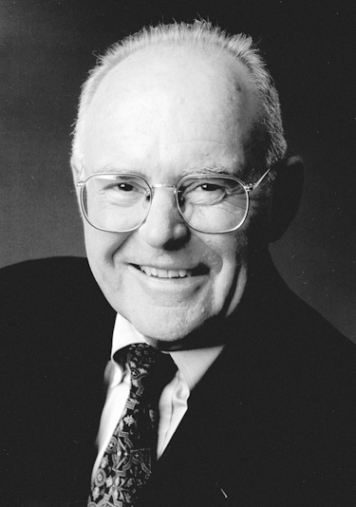
Gordon Moore, 1929-
Cofounded Intel in 1968 with Robert Noyce.
Moore’s Law: number of transistors on a computer chip doubles every year (observed in 1965)
Since 1975, transistor counts have doubled every two years.

Slide 88
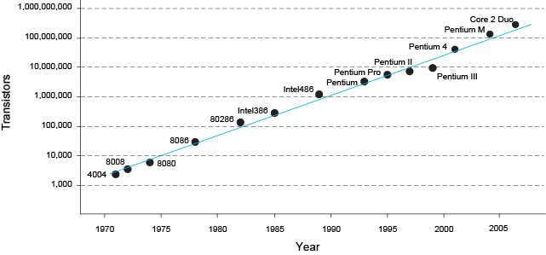
Moore’s Law
“If the automobile had followed the same development cycle as the computer, a Rolls-Royce would today cost $100, get one million miles to the gallon, and explode once a year . . .”
– Robert Cringley

Slide 89
Power Consumption
Power = Energy consumed per unit time
  Dynamic power consumption
  Static power consumption
Notes:
Power consumption is the amount of energy used per unit time.
Digital systems draw both dynamic and static power.
Dynamic power is the power used to charge capacitance as signals change between 0 and 1.
Static power is the power used even when signals do not change and the system is idle.

Slide 90
Dynamic Power Consumption
Power to charge transistor gate capacitances
  Energy required to charge a capacitance, C, to V_{DD} is CV_{DD}²
  Circuit running at frequency f: transistors switch (from 1 to 0 or vice versa) at that frequency
  Capacitor is charged f/2 times per second (discharging from 1 to 0 is free)
Dynamic power consumption:
P_{dynamic} = ½CV_{DD}²f
Notes:
Logic gates and the wires that connect them have capacitance.
If the voltage on the capacitor switches at frequency f (i.e., f times per second), it charges the capacitor f/2 times and discharges it f/2 times per second.
Discharging does not draw energy from the power supply, so the dynamic power consumption is

Slide 91
Static Power Consumption
Power consumed when no gates are switching
Caused by the quiescent supply current, I_{DD} (also called the leakage current)
Static power consumption:
P_{static} = I_{DD}V_{DD}

Slide 92
Power Consumption Example
Estimate the power consumption of a wireless handheld computer
  V_{DD} = 1.2 V
  C = 20 nF
  f = 1 GHz
  I_{DD} = 20 mA

Slide 93
Power Consumption Example
Estimate the power consumption of a wireless handheld computer
  V_{DD} = 1.2 V
  C = 20 nF
  f = 1 GHz
  I_{DD} = 20 mA
P = ½CV_{DD}²f + I_{DD}V_{DD}
= ½(20 nF)(1.2 V)²(1 GHz) +
(20 mA)(1.2 V)
= 14.4 W

